Slide 1
The Role of the Nucleus in Collective Cell Migration
Presented By: Brady Hine
Committee: Dr. Soham Ghosh, Dr. Kirk McGilvray, & Dr. Christian Puttlitz
Notes:
Hi, I’m Brady and this is my mid semester update presentation for my project investigating the nucleus’ physical role in collective cell migration.

Slide 2
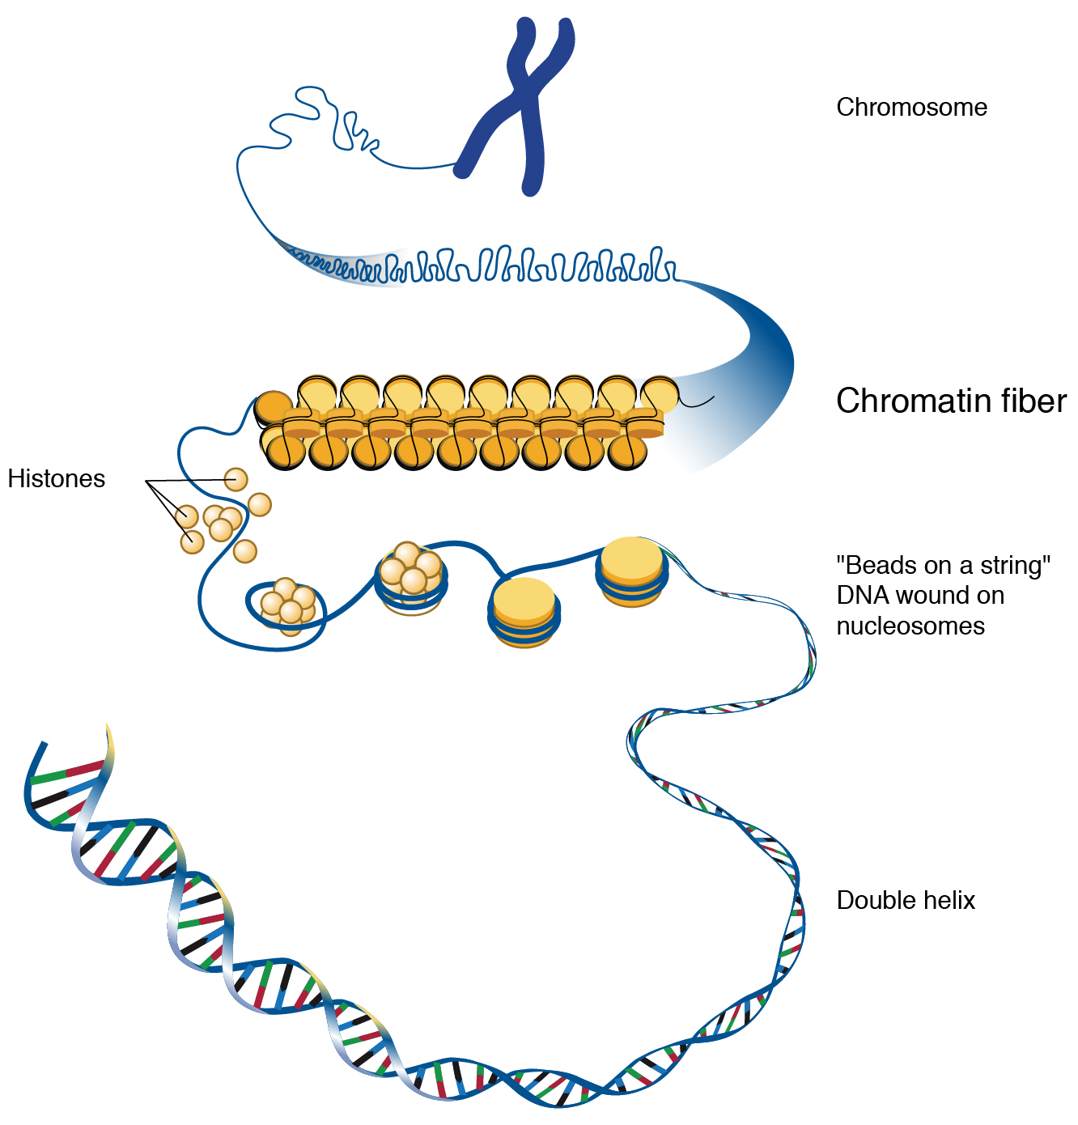
Introduction
Wound Healing
Critical for many tissue types
Aging can decrease the healing response
Condensed chromatin and softened nucleus
Collective Cell Migration
Necessary part of development, wound healing, & tissue engineering
Complex mechanical and chemical communication
[1] Chromatin, National Human Genome Research Institute
Notes:
That leads me to the specific aims for this project. The first of which being to establish the scratch wound assay that will be used to conduct these experiments. This aim will also include determining methods for quantifying migration as well as validating the setup by using the migration inhibitor Y27. The second aim for the project will involve observing how changes to nuclear mechanical factors impacts the quantified migration parameters. Modifying the nucleus will be done by applying GSK and Trichostatin A which will affect chromatin remodeling and nuclear stiffness.

Slide 3
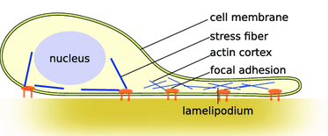
Introduction
Nucleus in Migration
Emerging as a defining factor
Largest and stiffest organelle
Moved by forces from the actin network
Scratch Wound Assay Model
Culture cell monolayer and scratch to observe healing
Simple and well-established
[2] Fruleux et al, 2016
Notes:
That leads me to the specific aims for this project. The first of which being to establish the scratch wound assay that will be used to conduct these experiments. This aim will also include determining methods for quantifying migration as well as validating the setup by using the migration inhibitor Y27. The second aim for the project will involve observing how changes to nuclear mechanical factors impacts the quantified migration parameters. Modifying the nucleus will be done by applying GSK and Trichostatin A which will affect chromatin remodeling and nuclear stiffness.

Slide 4
Specific Aims
Aim #1
Establish a scratch wound assay of cell migration using NIH-3T3 murine fibroblasts
Migration quantification and validation
Y27632 (myosin contraction inhibition)
Aim #2
Observe how changes to nuclear mechanics and chromatin affect migration parameters
Modify stiffness and chromatin remodeling
Trichostatin A (HDAC inhibition) and GSK126 (EZH2 inhibition)
Notes:
That leads me to the specific aims for this project. The first of which being to establish the scratch wound assay that will be used to conduct these experiments. This aim will also include determining methods for quantifying migration as well as validating the setup by using the migration inhibitor Y27. The second aim for the project will involve observing how changes to nuclear mechanical factors impacts the quantified migration parameters. Modifying the nucleus will be done by applying GSK and Trichostatin A which will affect chromatin remodeling and nuclear stiffness.

Slide 5
Specific Aims
Aim #3
Development of a predictive biophysical model to determine migration parameters from nuclear mechanics/chromatin inputs
Future Goal
Adapting the study to other cell types for further applied translational research
Notes:
The last specific aim for this project will involve using live staining and imaging of the nucleus and actin cytoskeleton during the scratch wound assay. This data will then be used to develop a strain map at the cell monolayer level providing detailed mechanical insight into the migration process. If these aims are successfully met, it’d help lay groundwork for looking into interactions of nuclear mechanics with cell crowding effects and substrate mechanics as well as adaption of the assay to MSCs.

Slide 6
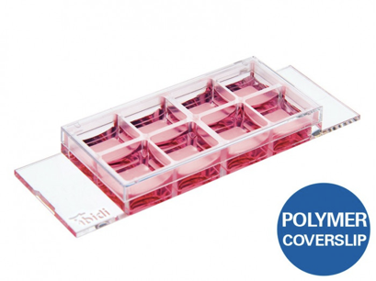
Methods – Scratch Wound Assay
Well Plate Functionalization
ibidi® 8 well µ-Slide plate (Cat no: 80826)
Collagen solution (Gibco A10664)
Prior plasma treatment, 30-minute deposition
Assay Protocol
Seeded NIH-3T3 murine fibroblasts and provided medium
Fibroblast medium (ATCC 30-2022) supplemented with Pen/Strep (Gibco 15140-122) and FBS (Gibco 261-40-079)
48-hour incubation to confluency
Scratch applied with 200μL pipette tip guided by a straightedge
Quick PBS rinse and fresh medium applied
Notes:
The last specific aim for this project will involve using live staining and imaging of the nucleus and actin cytoskeleton during the scratch wound assay. This data will then be used to develop a strain map at the cell monolayer level providing detailed mechanical insight into the migration process. If these aims are successfully met, it’d help lay groundwork for looking into interactions of nuclear mechanics with cell crowding effects and substrate mechanics as well as adaption of the assay to MSCs.

Slide 7
Methods – Migration Imaging
Microscope
Zeiss LSM 980 inverted confocal microscope
Regulated temperature (37° C), CO2 concentration (5%), and humidity level
Medium replenishment
Image Formats
Live stained
NucBlue (Thermo Fisher)
Fixed stained
DAPI (Thermo Fisher) and phalloidin (Thermo Fisher)
Brightfield
Notes:
The last specific aim for this project will involve using live staining and imaging of the nucleus and actin cytoskeleton during the scratch wound assay. This data will then be used to develop a strain map at the cell monolayer level providing detailed mechanical insight into the migration process. If these aims are successfully met, it’d help lay groundwork for looking into interactions of nuclear mechanics with cell crowding effects and substrate mechanics as well as adaption of the assay to MSCs.

Slide 8
Methods – Nuclear Alterations
Drug Applications
Chromatin condensing
20μM GSK126 (Sigma)
EZH2 methyltransferase inhibitor
Nuclear softening
100 ng/ml Trichostatin A (TSA) (Sigma)
Class I and II histone deacetylase inhibitor
Application Protocol
Drugs applied 24 hours before scratch in biohood
Also applied in medium given post scratch
Notes:
The last specific aim for this project will involve using live staining and imaging of the nucleus and actin cytoskeleton during the scratch wound assay. This data will then be used to develop a strain map at the cell monolayer level providing detailed mechanical insight into the migration process. If these aims are successfully met, it’d help lay groundwork for looking into interactions of nuclear mechanics with cell crowding effects and substrate mechanics as well as adaption of the assay to MSCs.

Slide 9
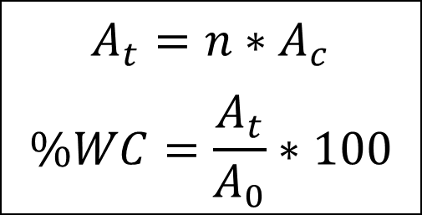
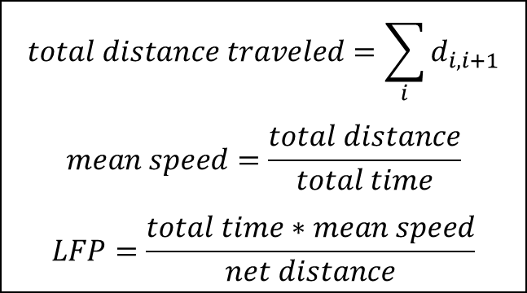
Methods – Image Processing
Wound Closure Percentage
Processing done using open-source Fiji
Calculate initial wound area
Count # of cells at given time and calculate average area
Automated Cell Tracking
Performed using the Fiji plugin TrackMate and nuclear stained images
Images to binary mask enabling spot detection
Spot positions stitched between frames to create migration tracks
Calculation of parameters of interest
Total distance travelled, mean speed, & linearity of forward progression (LFP)
$$A_{t}=n∗A_{c}$$
$$\%WC=\frac{A_{t}}{A_{0}}∗100$$
$$total distance traveled=\sum_{i}{d_{i,i+1}}$$
$$mean speed=\frac{total distance}{total time}$$
$$LFP=\frac{total time∗mean speed}{net distance}$$
[3] Ershov, D. et al, 2021
Notes:
The last specific aim for this project will involve using live staining and imaging of the nucleus and actin cytoskeleton during the scratch wound assay. This data will then be used to develop a strain map at the cell monolayer level providing detailed mechanical insight into the migration process. If these aims are successfully met, it’d help lay groundwork for looking into interactions of nuclear mechanics with cell crowding effects and substrate mechanics as well as adaption of the assay to MSCs.

Slide 10
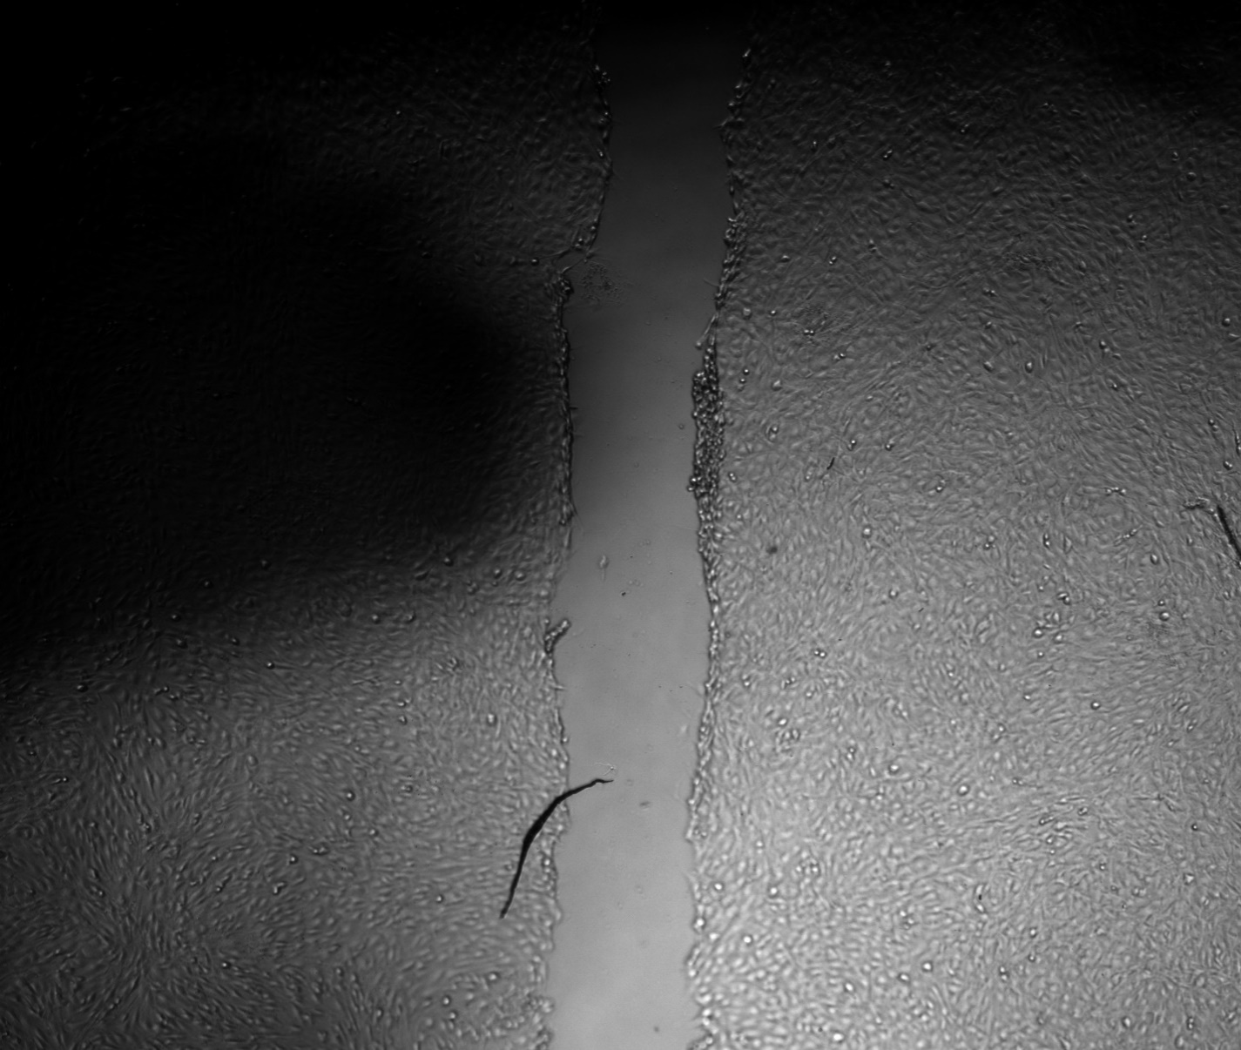
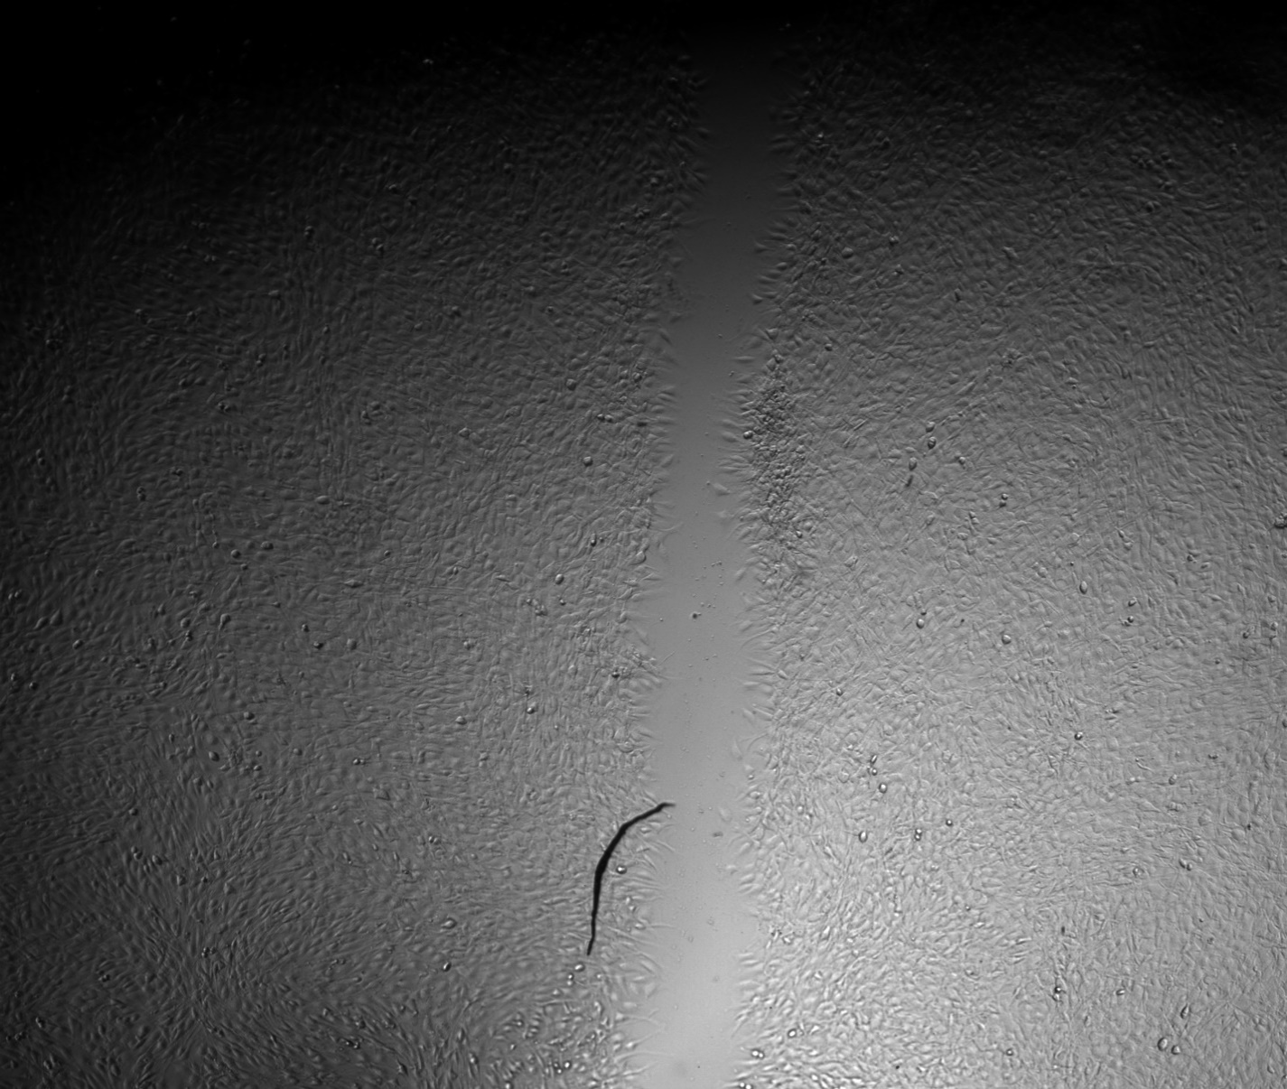
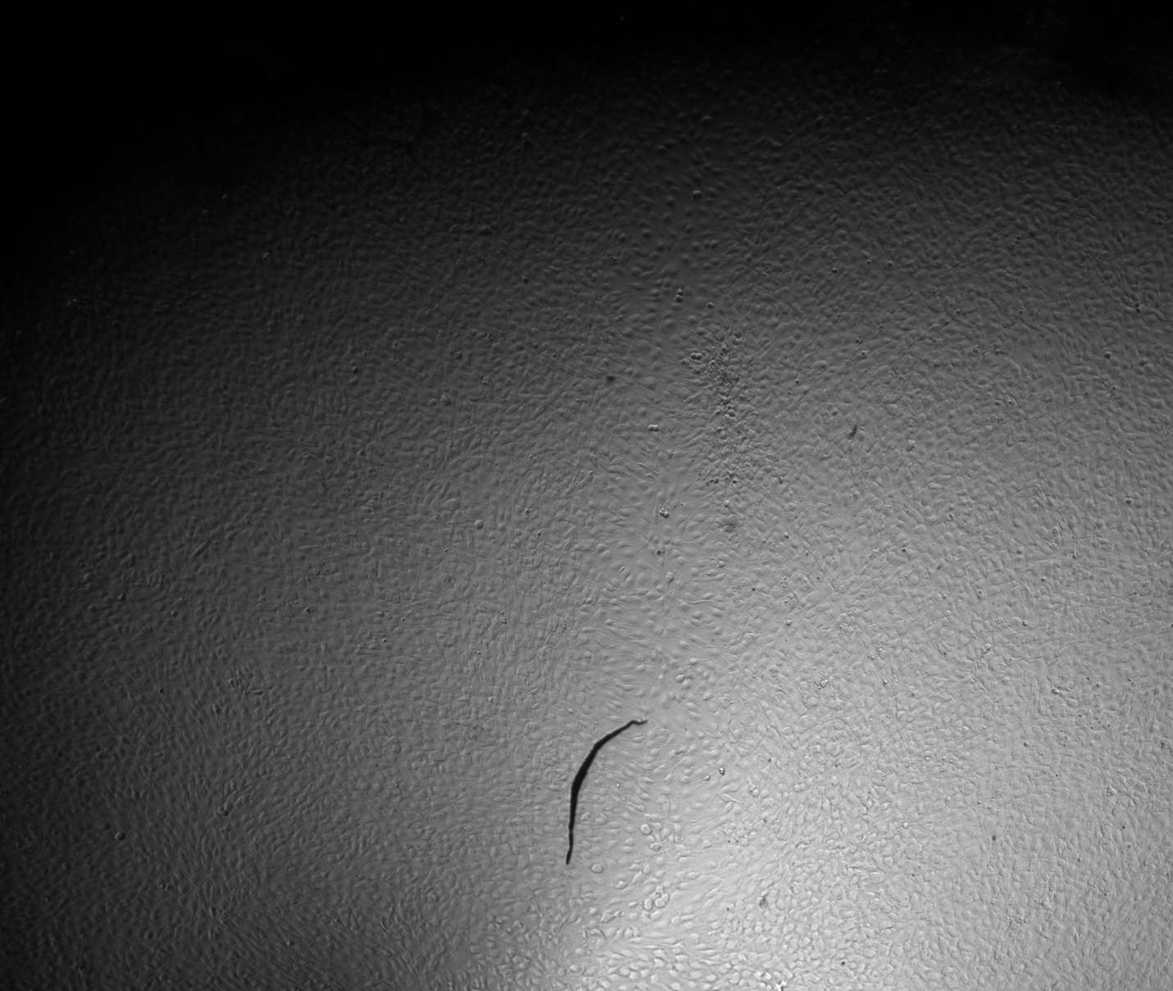
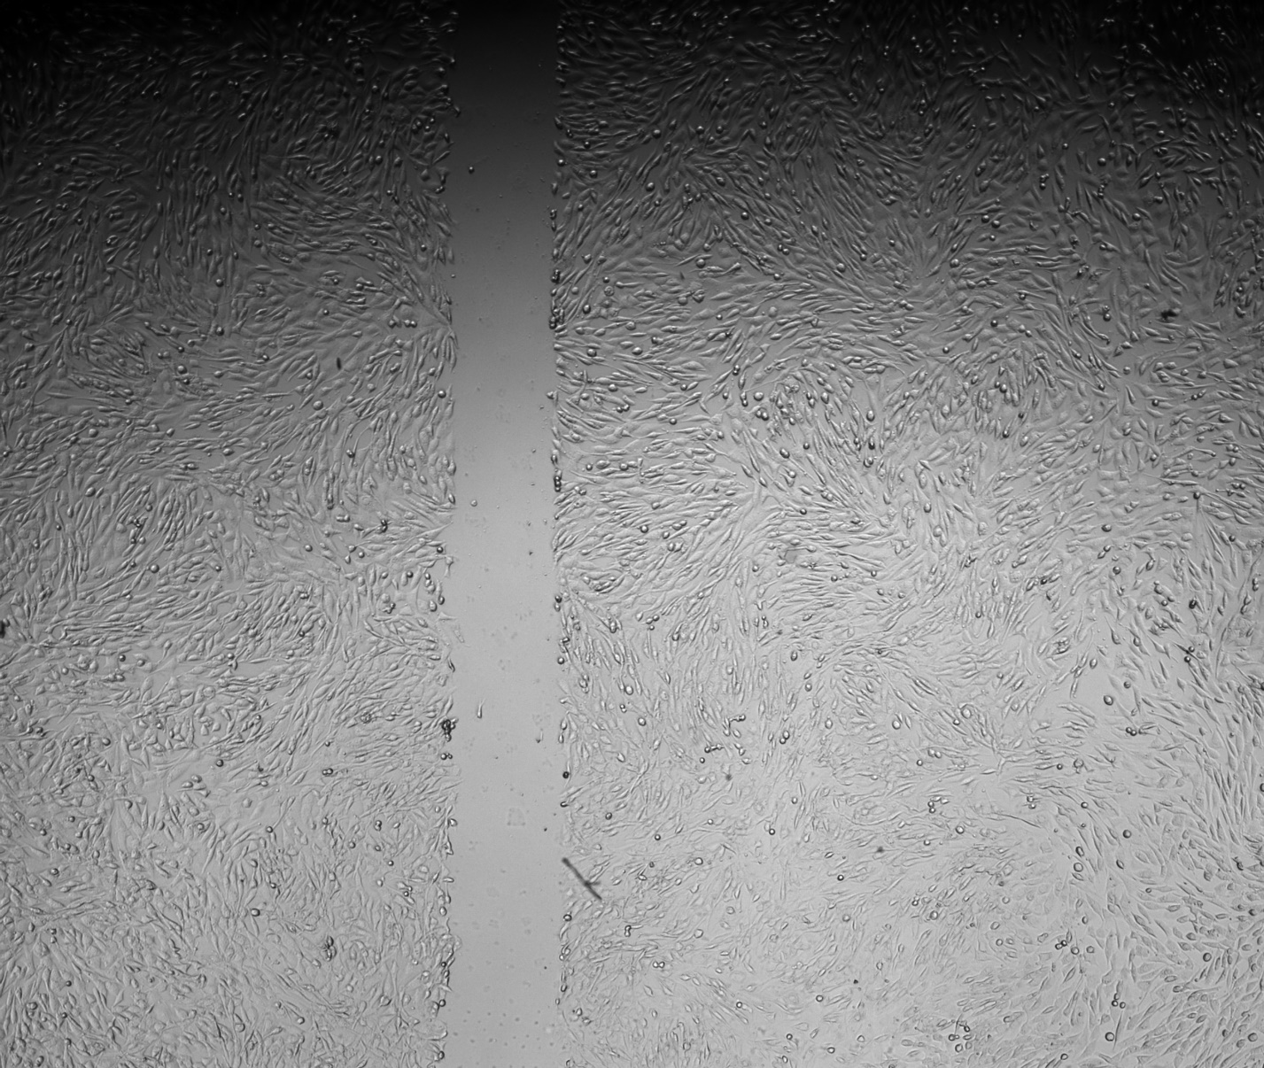
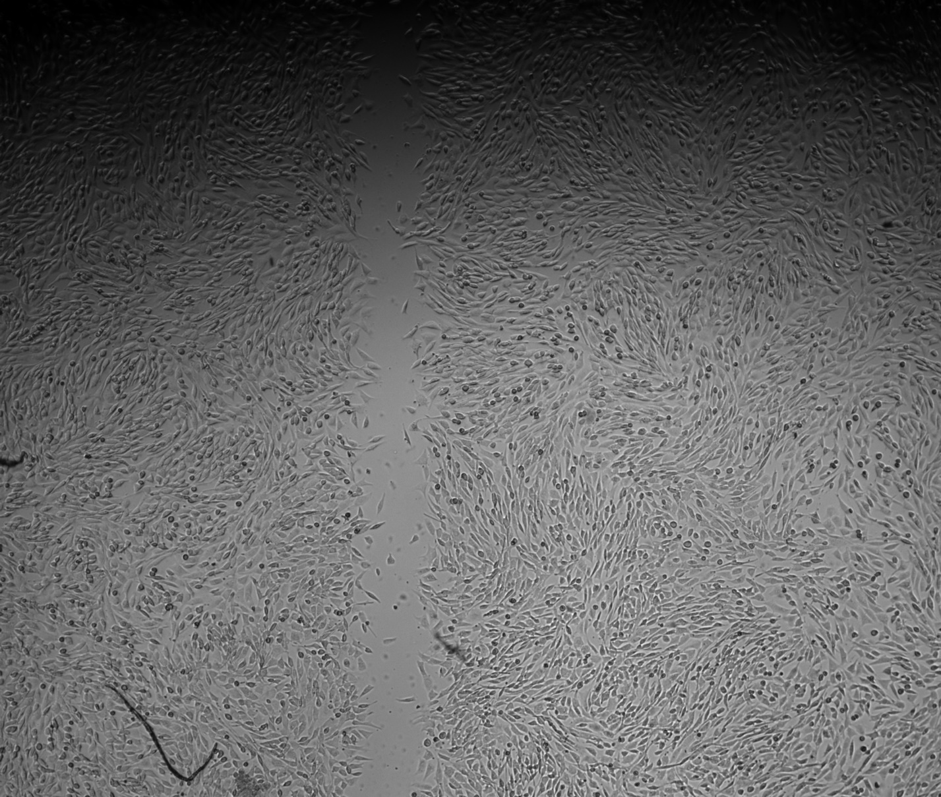
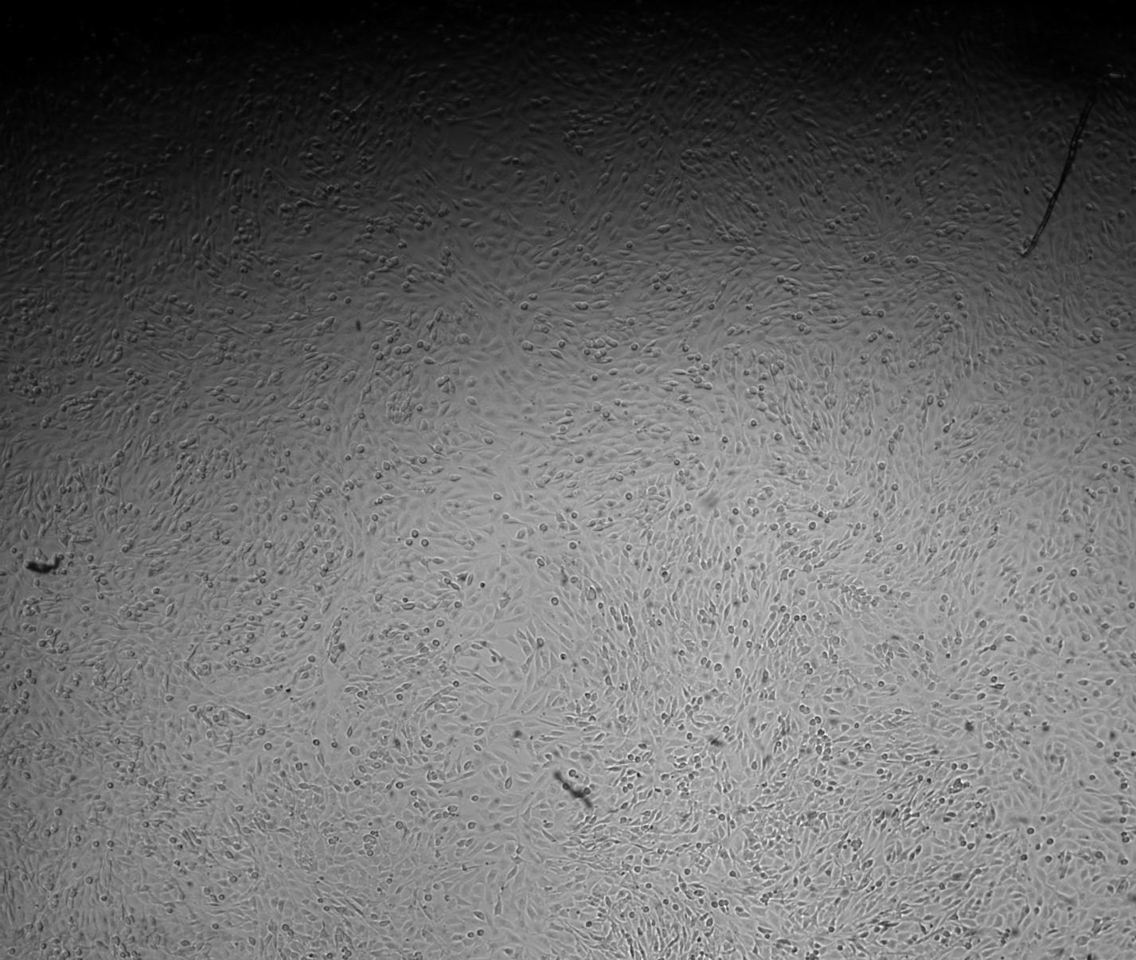
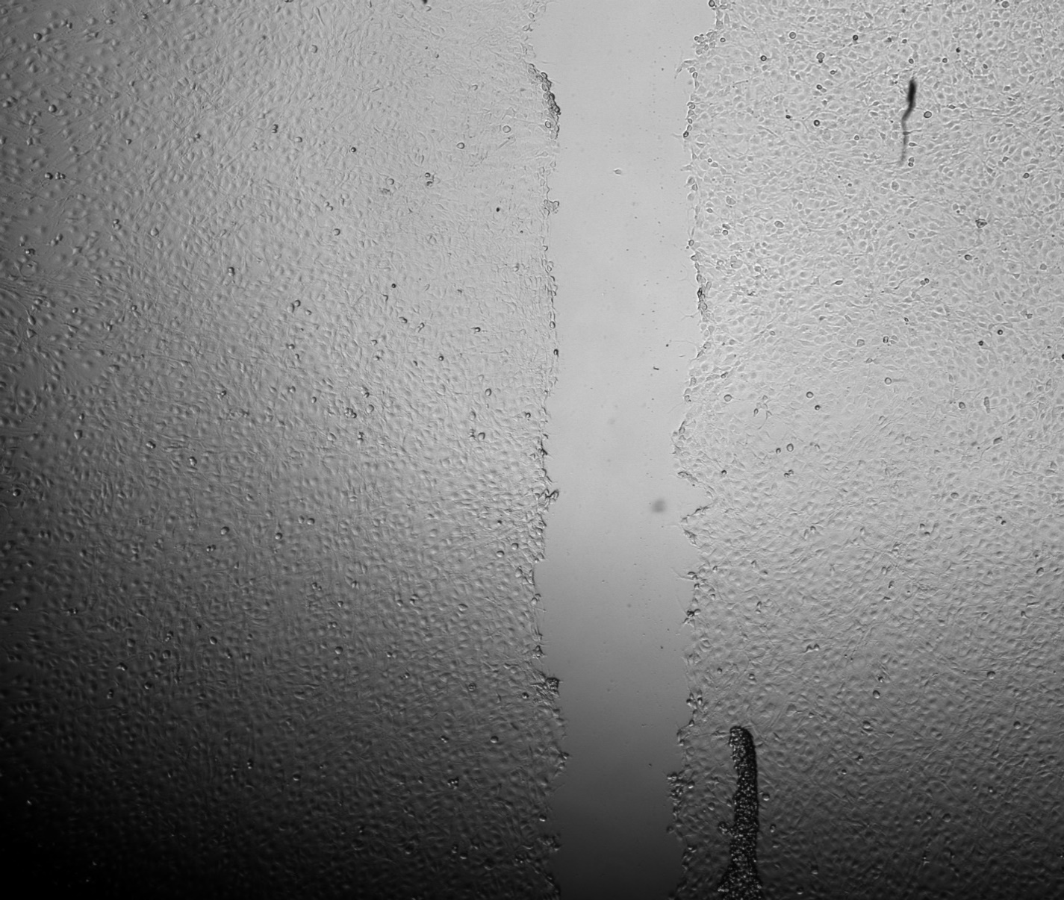
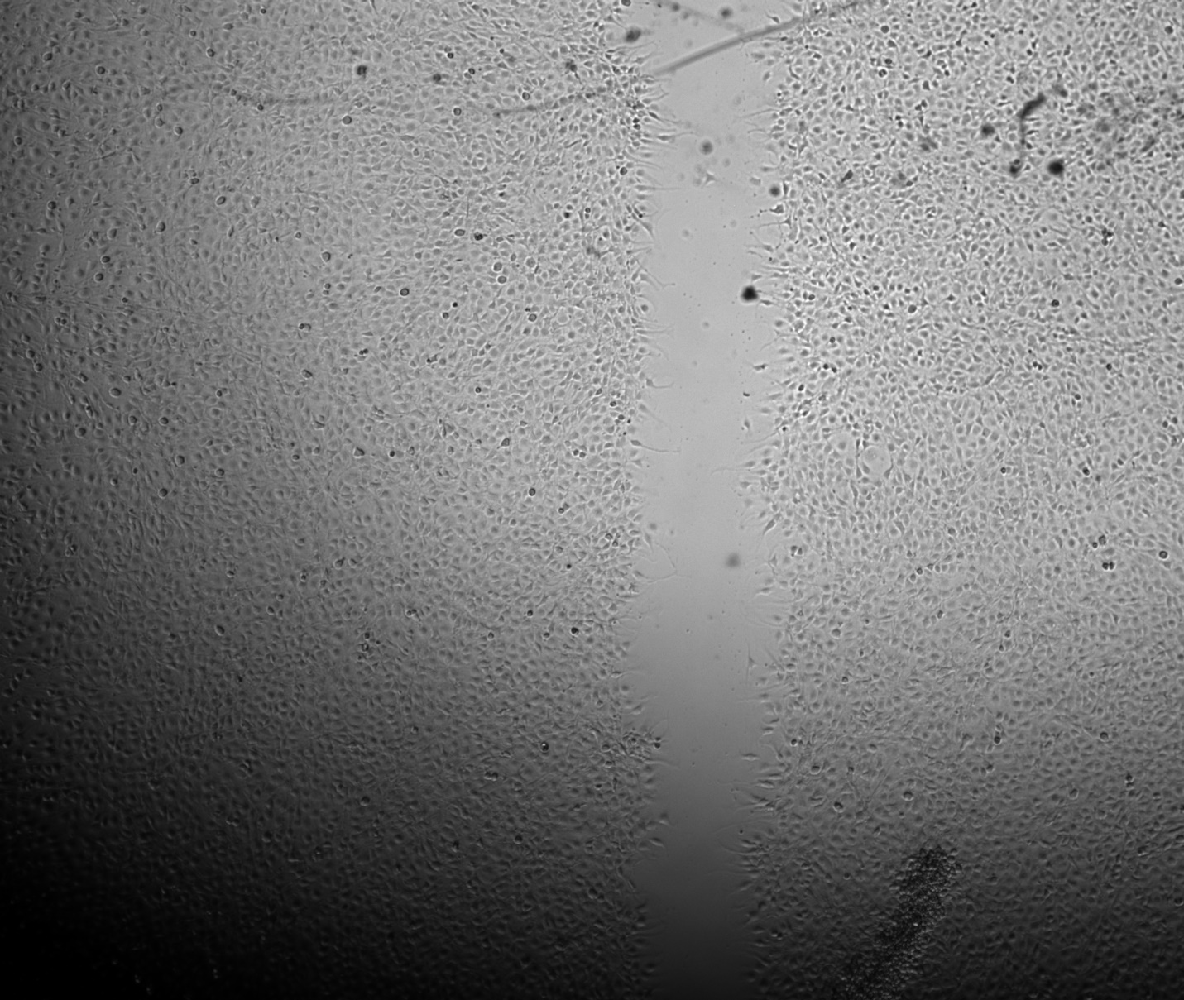
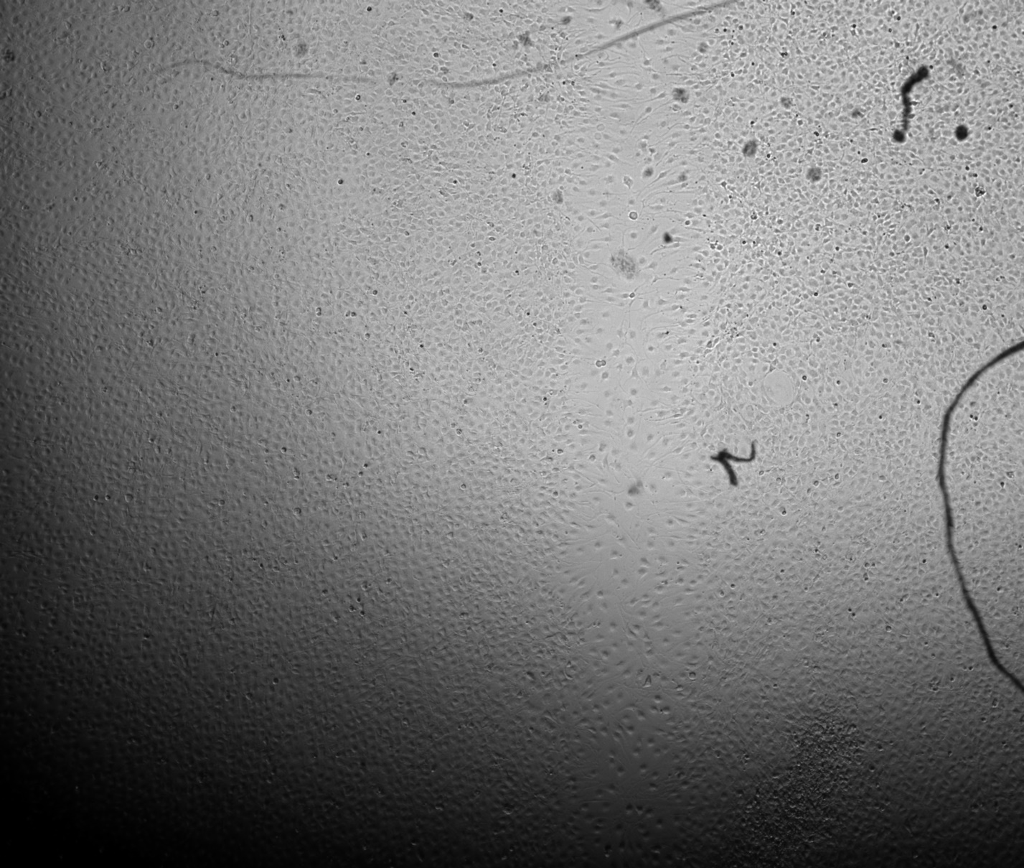
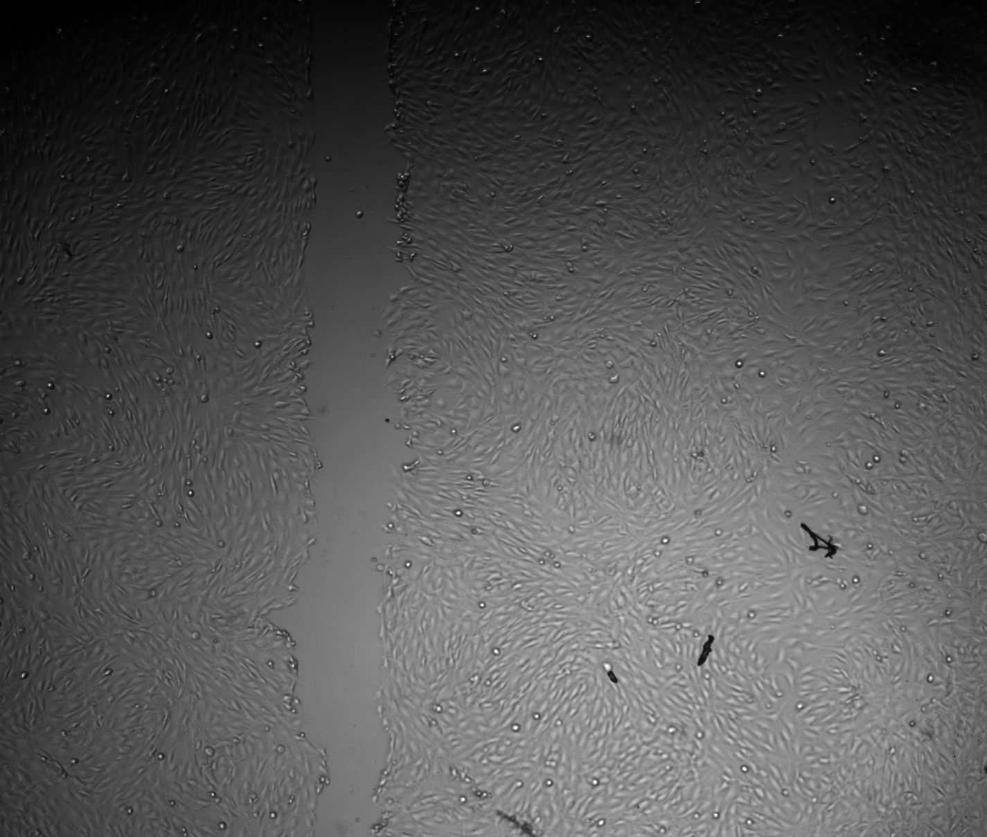
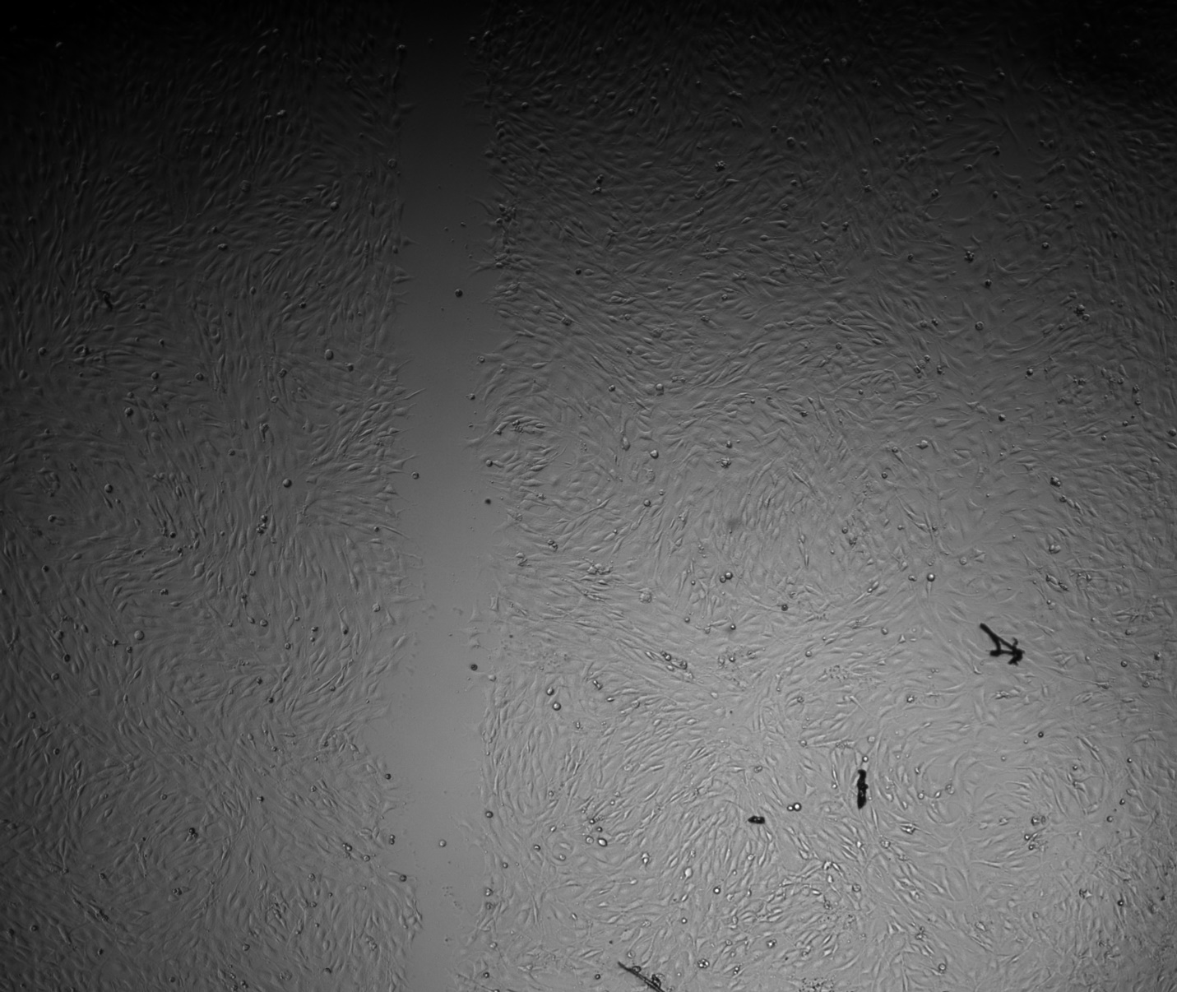
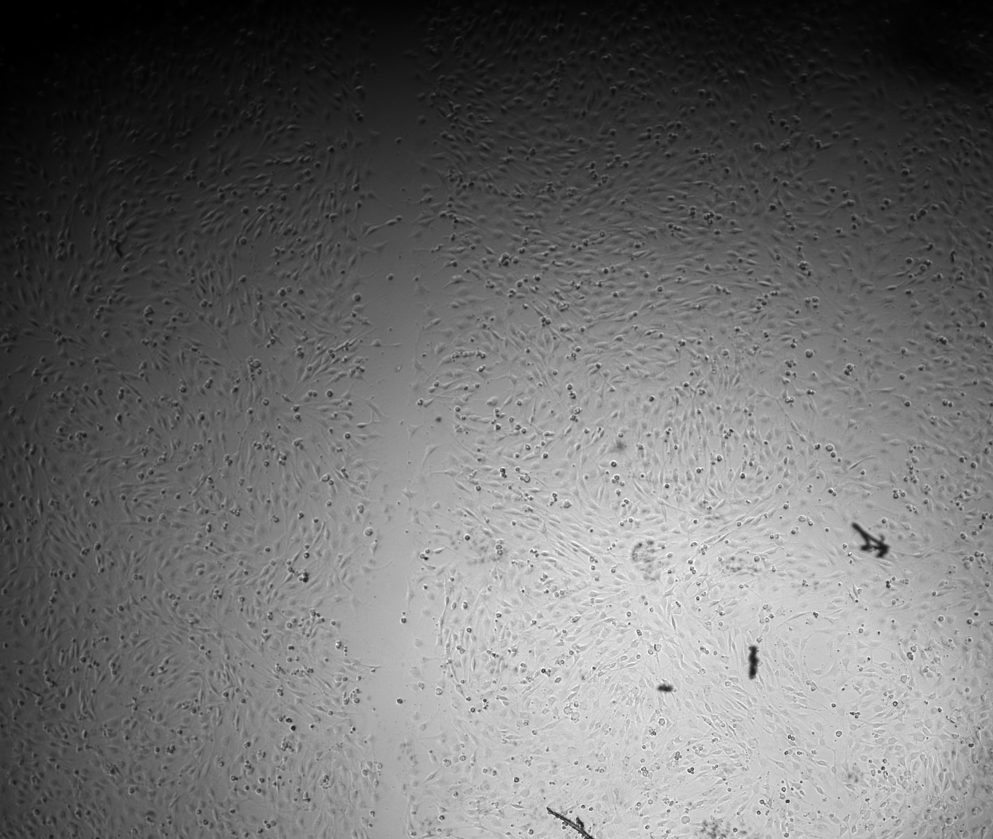
Results – Assay Validation
Control Group
20μM GSK126
200μm
200μm
0 hours
4 hours
21 hours
0 hours
4 hours
21 hours
20μM Y27632
100 ng/mL Trichostatin A
200μm
200μm
Notes:
The last specific aim for this project will involve using live staining and imaging of the nucleus and actin cytoskeleton during the scratch wound assay. This data will then be used to develop a strain map at the cell monolayer level providing detailed mechanical insight into the migration process. If these aims are successfully met, it’d help lay groundwork for looking into interactions of nuclear mechanics with cell crowding effects and substrate mechanics as well as adaption of the assay to MSCs.

Slide 11
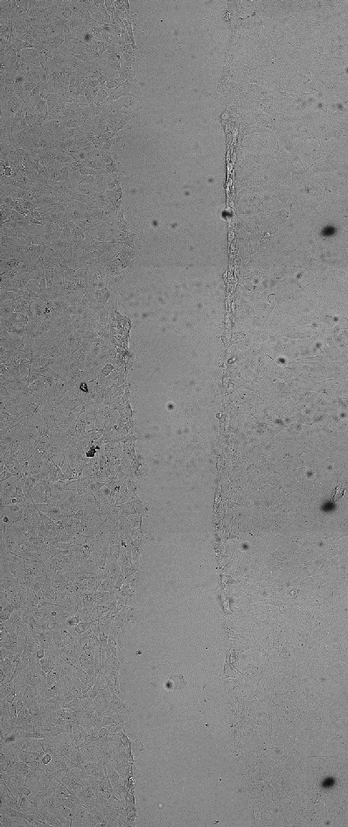
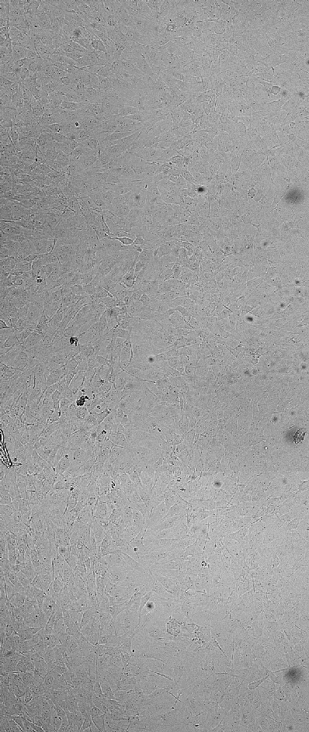
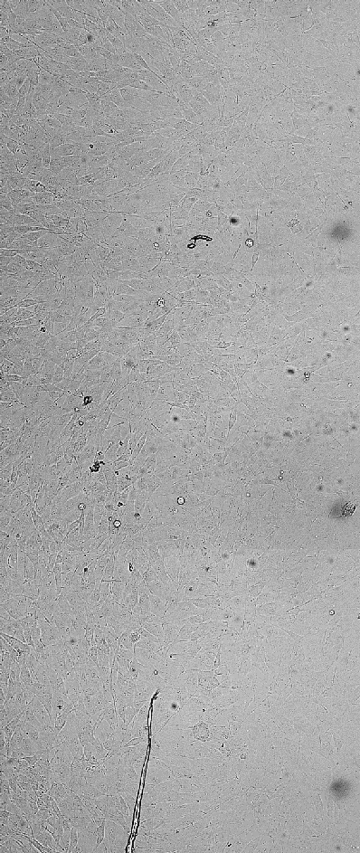
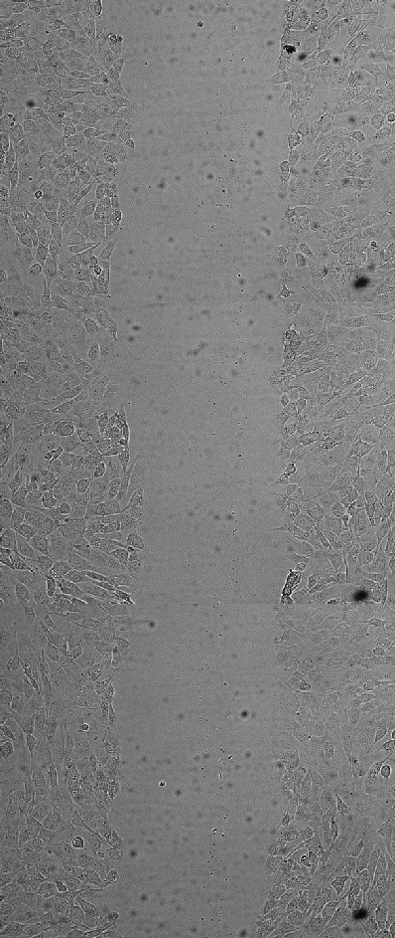
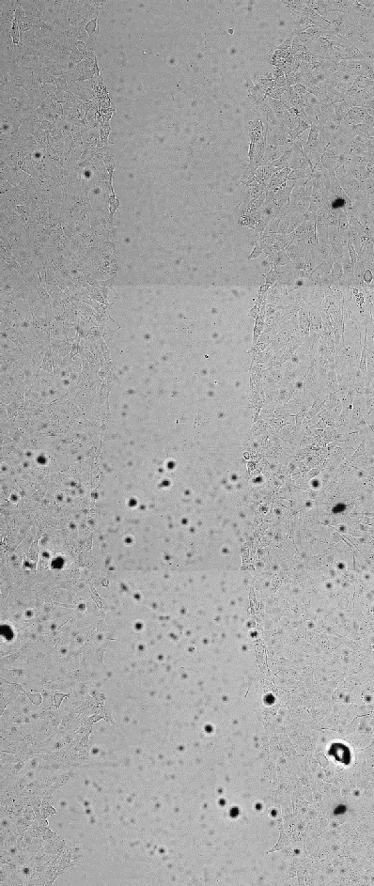
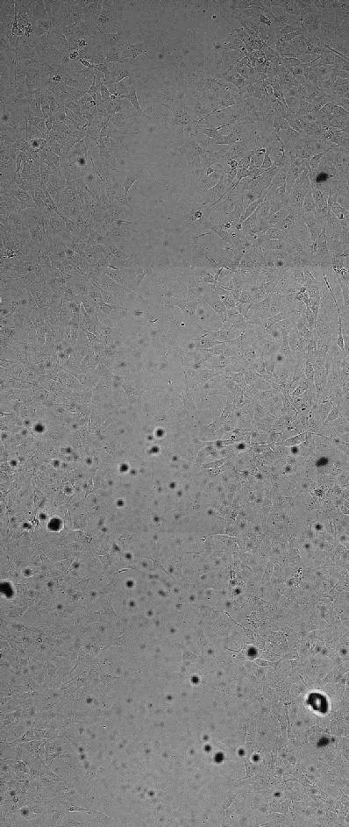
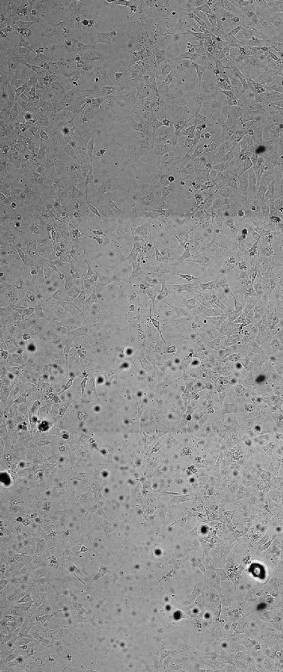
Results – Wound Closure
Control Group
Graphic Summary
Brightfield images taken at 30-minute intervals
0-25.5 hours post scratch application
Fixed stained images taken after 25.5 hours
%WC quantified at 11 and 24 hours
20μM GSK126
*
*
100 ng/mL TSA
*
*
0 hours
11 hours
24 hours
25.5 hours
Notes:
The last specific aim for this project will involve using live staining and imaging of the nucleus and actin cytoskeleton during the scratch wound assay. This data will then be used to develop a strain map at the cell monolayer level providing detailed mechanical insight into the migration process. If these aims are successfully met, it’d help lay groundwork for looking into interactions of nuclear mechanics with cell crowding effects and substrate mechanics as well as adaption of the assay to MSCs.

Slide 12
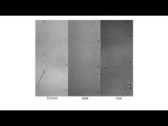
Results – Cell Tracking
Graphic Summary
Nuclei stained with NucBlue
2-8.5 hours post scratch w/ 30-minute intervals
Nuclear structure enlarged at 5.5 hours
Control Group
20μM GSK126
100 ng/mL TSA
2 hours
2 hours
5.5 hours
8.5 hours
Notes:
The last specific aim for this project will involve using live staining and imaging of the nucleus and actin cytoskeleton during the scratch wound assay. This data will then be used to develop a strain map at the cell monolayer level providing detailed mechanical insight into the migration process. If these aims are successfully met, it’d help lay groundwork for looking into interactions of nuclear mechanics with cell crowding effects and substrate mechanics as well as adaption of the assay to MSCs.

Slide 13
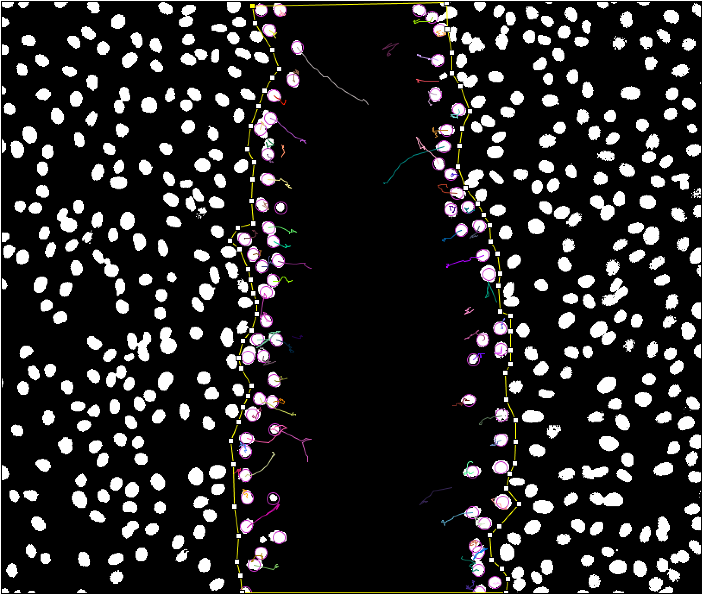
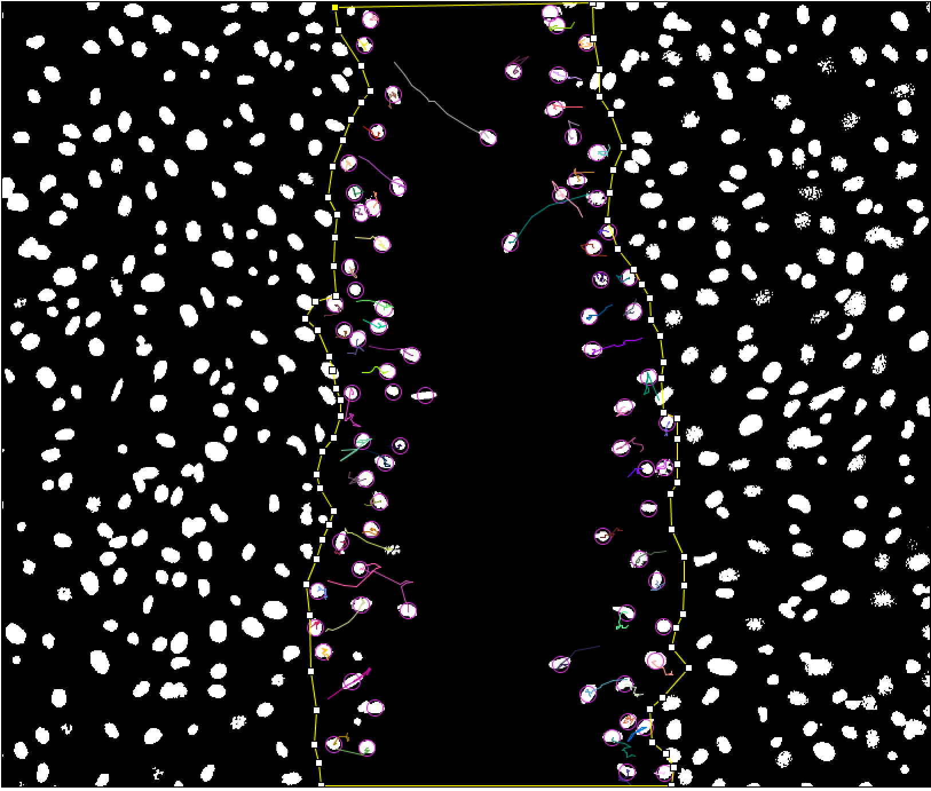
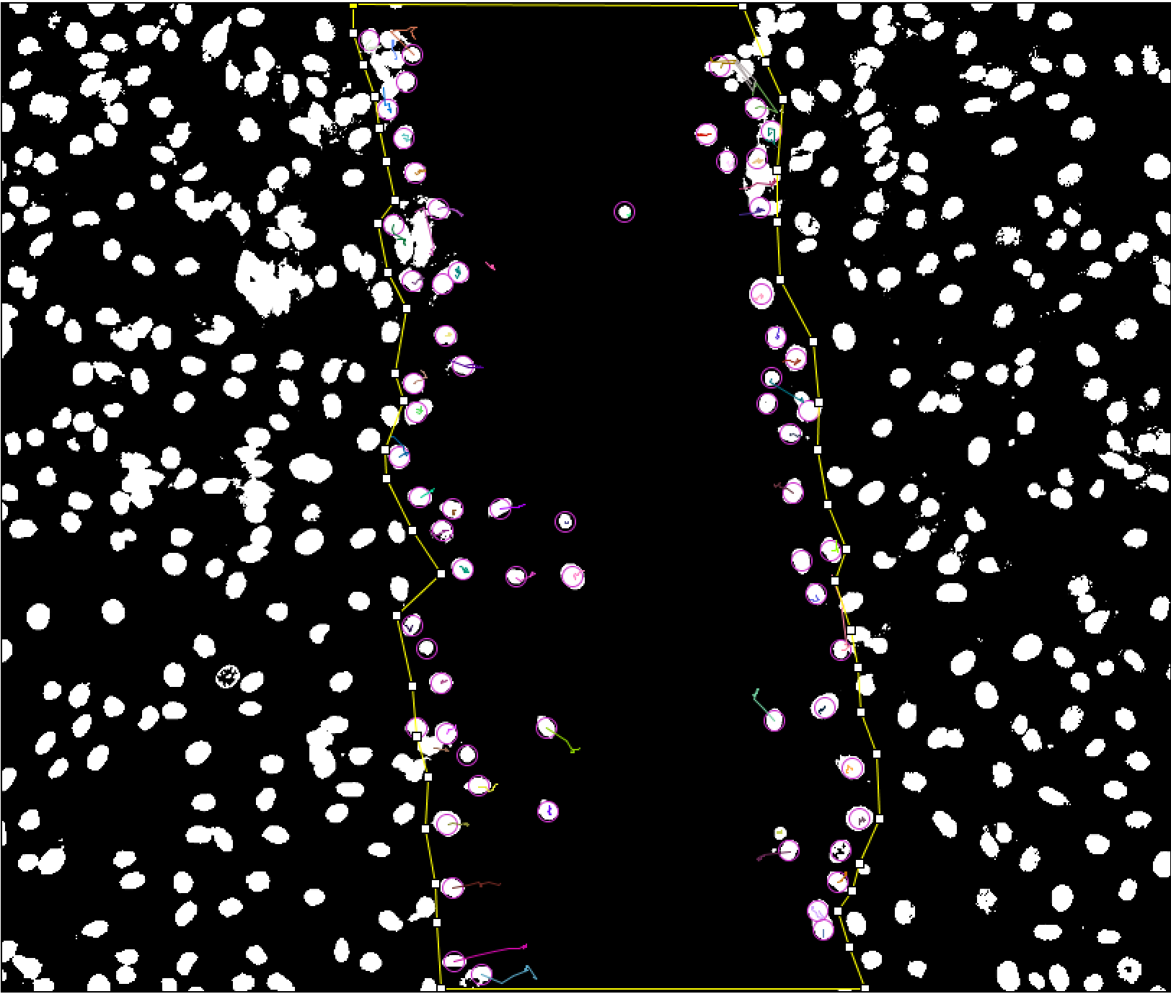
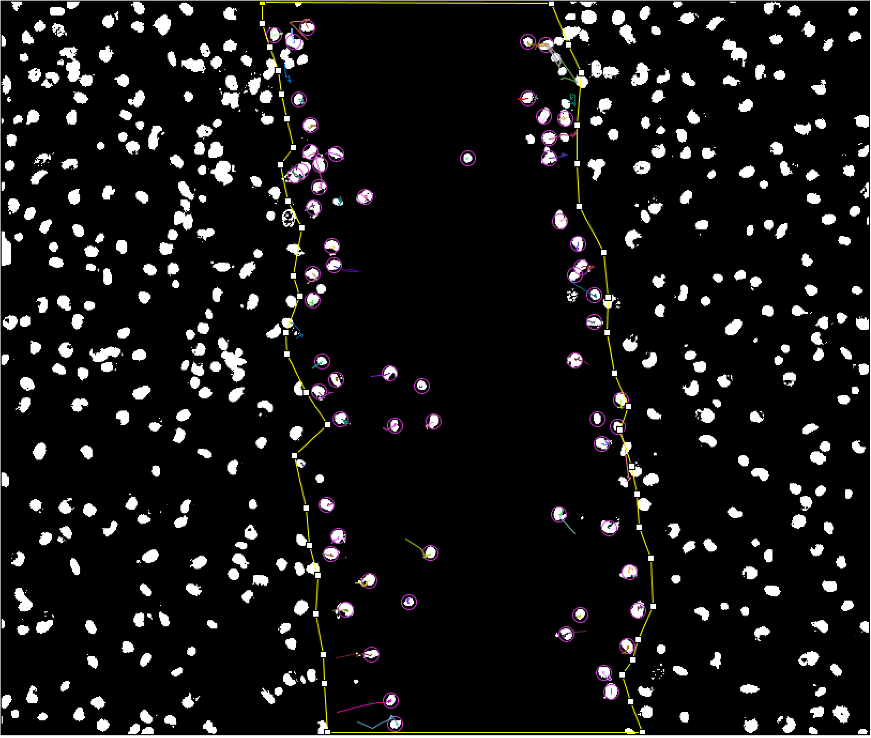
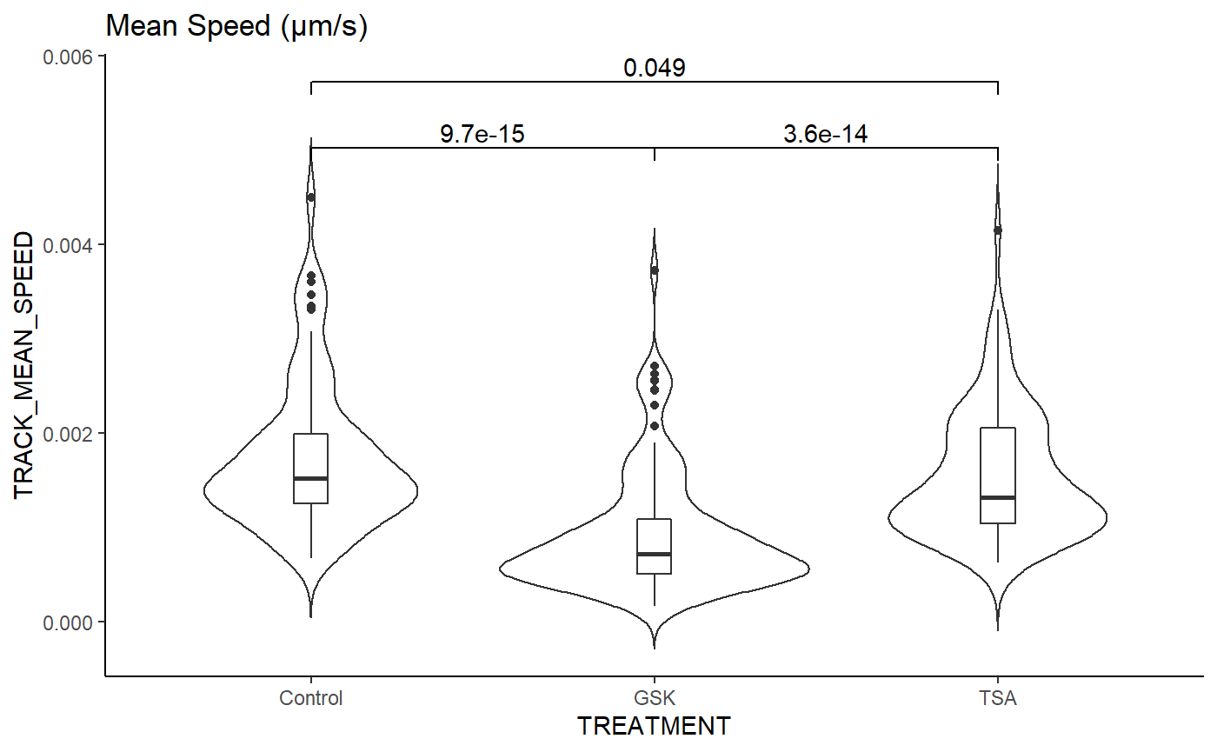
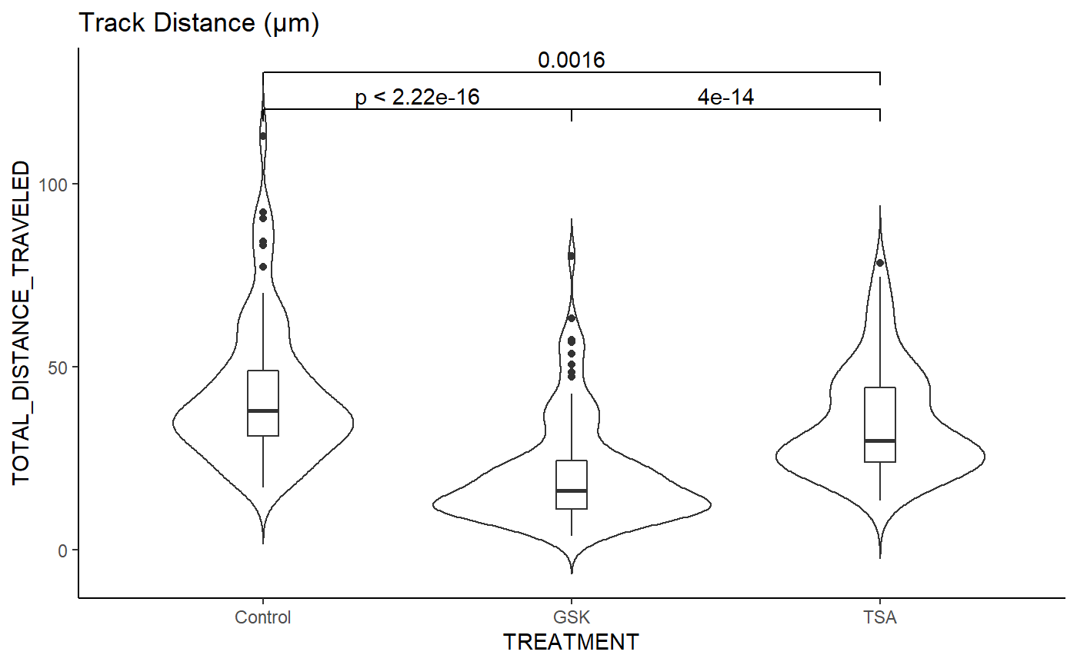
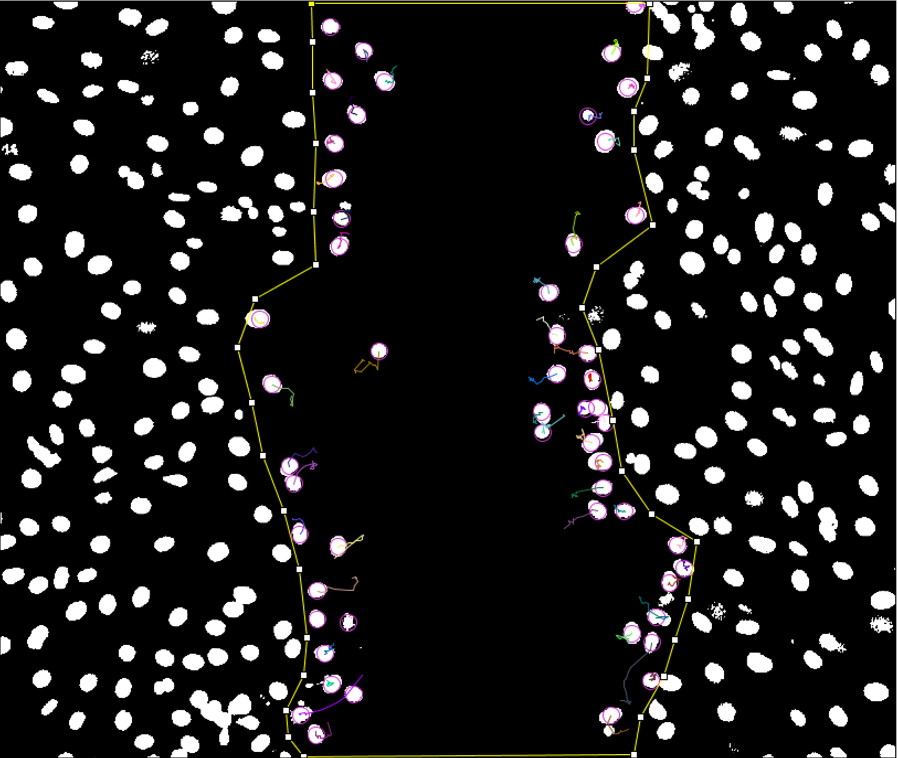
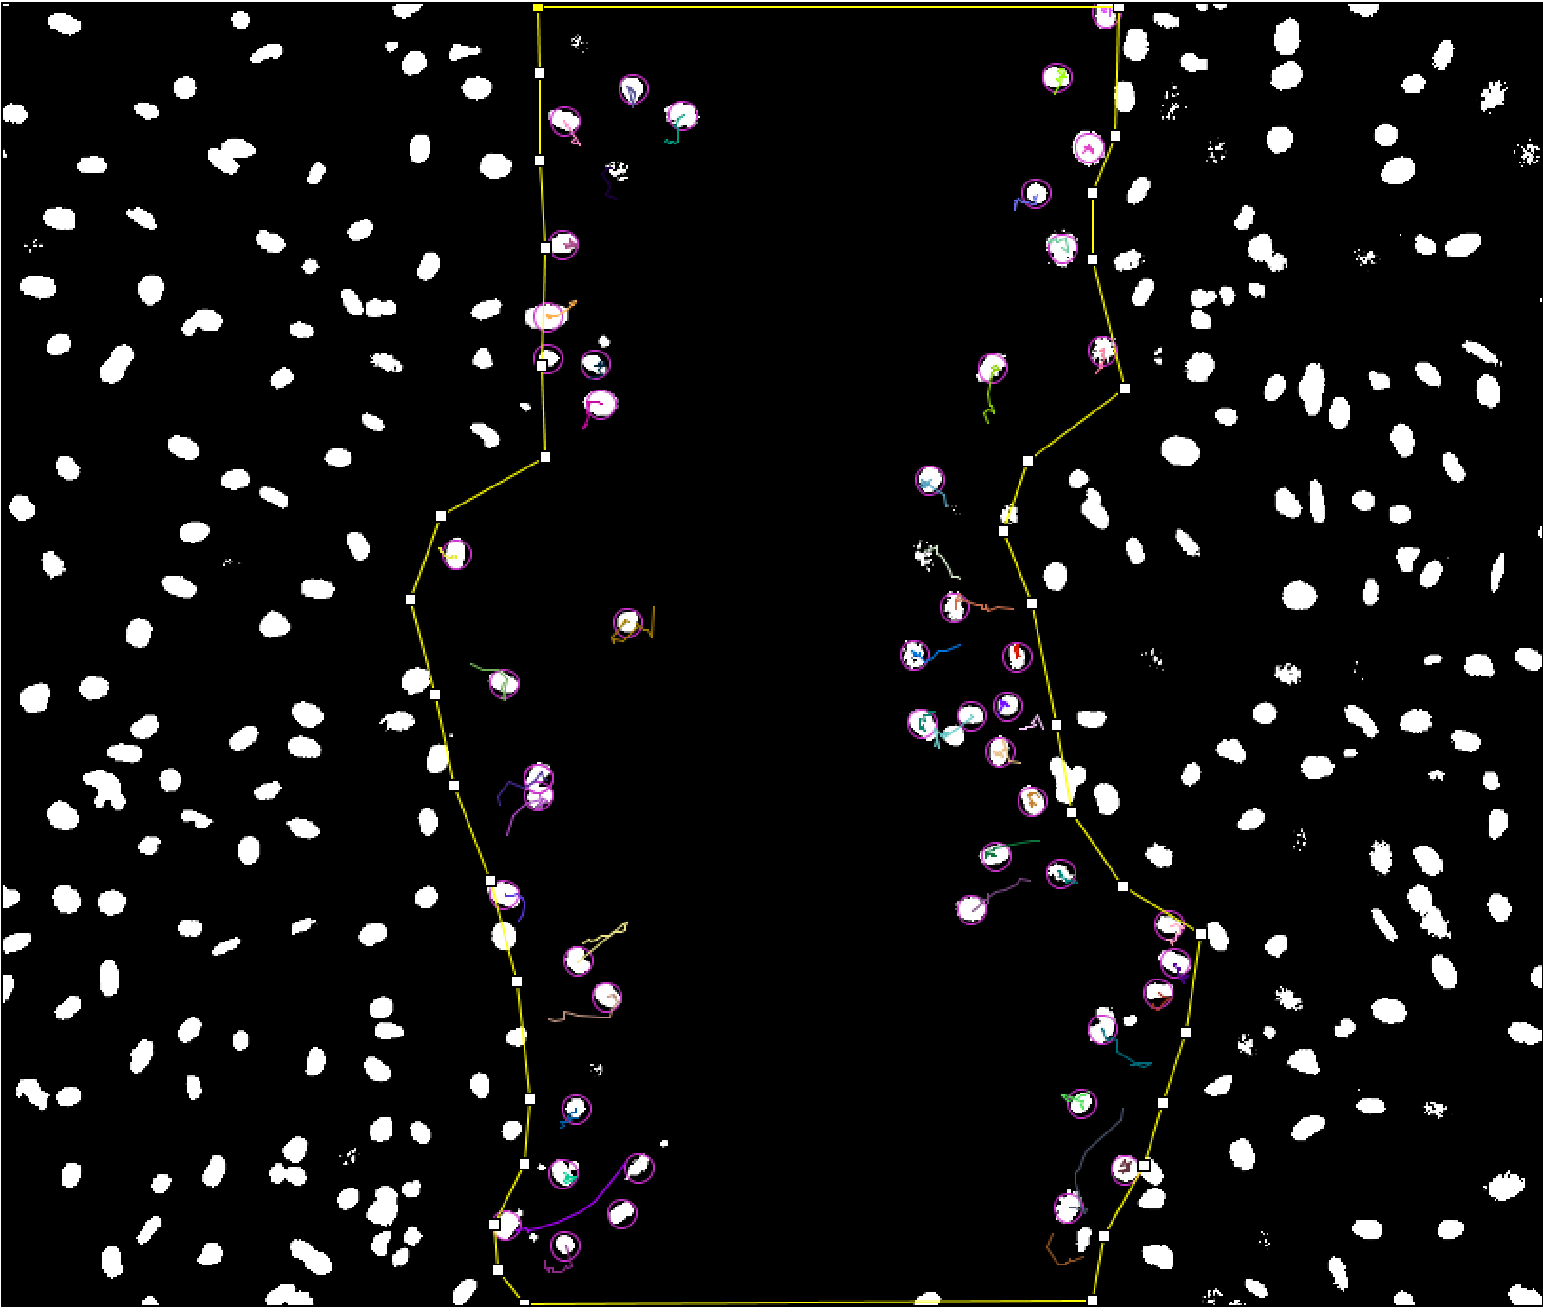
Results – Cell Tracking
Control Group
Graphic Summary
Automated cell tracking used with images from last slide
Tracking visual shown at the initial and end timepoints
Spot detection: purple rings
Colored lines: migration tracks
Migration parameters quantified with violin plots
20μM GSK126
100 ng/mL TSA
2 hours
2 hours
8.5 hours
Notes:
The last specific aim for this project will involve using live staining and imaging of the nucleus and actin cytoskeleton during the scratch wound assay. This data will then be used to develop a strain map at the cell monolayer level providing detailed mechanical insight into the migration process. If these aims are successfully met, it’d help lay groundwork for looking into interactions of nuclear mechanics with cell crowding effects and substrate mechanics as well as adaption of the assay to MSCs.

Slide 14
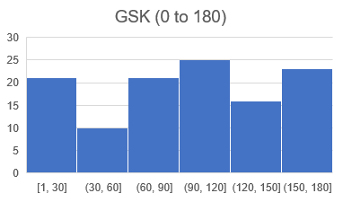
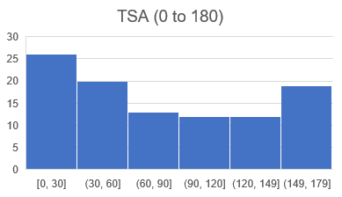
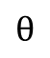
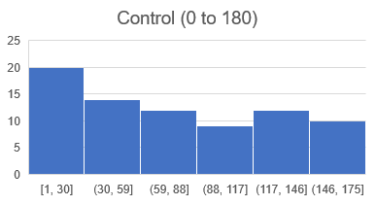
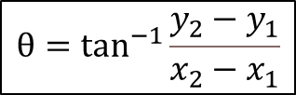
Results – Migration Trajectory
Angular trajectory from horizontal
Linearity of forward progression doesn’t reveal much about migration
Random walks can be seen as persistent
Trajectory gives information about following collective cell migration gradients
$$θ$$
$$θ=\tan^{−1}{\frac{y_{2}−y_{1}}{x_{2}−x_{1}}}$$
Notes:
The last specific aim for this project will involve using live staining and imaging of the nucleus and actin cytoskeleton during the scratch wound assay. This data will then be used to develop a strain map at the cell monolayer level providing detailed mechanical insight into the migration process. If these aims are successfully met, it’d help lay groundwork for looking into interactions of nuclear mechanics with cell crowding effects and substrate mechanics as well as adaption of the assay to MSCs.

Slide 15
Results – Migration Trajectory
GSK treatments showed a significantly larger θ than the control and TSA groups
TSA and control groups had statistically similar θ values
*
Treatment | Mean Theta | Standard Deviation
Control | 77.5° | 53.9°
GSK | 94.0° | 52.9°
TSA | 80.7° | 55.8°
Notes:
The last specific aim for this project will involve using live staining and imaging of the nucleus and actin cytoskeleton during the scratch wound assay. This data will then be used to develop a strain map at the cell monolayer level providing detailed mechanical insight into the migration process. If these aims are successfully met, it’d help lay groundwork for looking into interactions of nuclear mechanics with cell crowding effects and substrate mechanics as well as adaption of the assay to MSCs.

Slide 16
Results – Actin Structure
Actin network – engine of motility
Are the treatments having an effect on the actin structure?
All exhibited the fibrous F-actin
Control
GSK
TSA
Notes:
The last specific aim for this project will involve using live staining and imaging of the nucleus and actin cytoskeleton during the scratch wound assay. This data will then be used to develop a strain map at the cell monolayer level providing detailed mechanical insight into the migration process. If these aims are successfully met, it’d help lay groundwork for looking into interactions of nuclear mechanics with cell crowding effects and substrate mechanics as well as adaption of the assay to MSCs.

Slide 17
Recap
Scratch wound assay was validated with 20μM Y27632 – myosin contraction inhibitor
TSA and GSK treatments showed a decrease in wound closure percentage
Evidence that nuclear softening and chromatin condensing both decrease the wound healing response
TSA treated cells exhibited a reduction in migration speed and distance
A more drastic decrease for these parameters was seen with the GSK treatment
Evidence that while nuclear stiffness and chromatin both affect migration, chromatin structure may play a larger role
GSK migration trajectory angles are larger than the TSA and control groups
TSA and control groups exhibited statistically similar values
Evidence that changes in the chromatin structure by GSK disrupts the ability of cells to follow collective migration gradients
No difference in actin structure was seen from a qualitative perspective between groups
Evidence that condensed chromatin structure is limiting the cell migration through a different manner exclusive to the nucleus
Notes:
The last specific aim for this project will involve using live staining and imaging of the nucleus and actin cytoskeleton during the scratch wound assay. This data will then be used to develop a strain map at the cell monolayer level providing detailed mechanical insight into the migration process. If these aims are successfully met, it’d help lay groundwork for looking into interactions of nuclear mechanics with cell crowding effects and substrate mechanics as well as adaption of the assay to MSCs.

Slide 18
Final Remarks
Initial GANTT Chart | December | January | February | March | April
1 – Aim 1 Validation
2 – Aim 1 Baseline
3 – Aim 2 Data Collection & Analysis
4 – Aim 3 Experiment Replication
5 – Aim 3 Strain Mapping
6 – E-days Preparation
Strain mapping and predictive model creation was too ambitious for the timeline provided in MECH 498
Future studies:
Currently planned for this to provide a new direction for Dr. Ghosh’s lab
Targeting mechanisms studied here in reverse for aged fibroblasts to try and increase their wound healing
Further adaptation of this study to include other cell types
Work won 2nd place at E-Days and plan to write first author manuscript on this
Overall GANTT Chart | December | January | February | March | April
1 – Aim 1 Validation
2 – Aim 1 Baseline
3 – Aim 2 Data Collection & Analysis
4 – Aim 3 Modeling Research
5 – Aim 3 Model Creation
6 – E-days Preparation
Notes:
The last specific aim for this project will involve using live staining and imaging of the nucleus and actin cytoskeleton during the scratch wound assay. This data will then be used to develop a strain map at the cell monolayer level providing detailed mechanical insight into the migration process. If these aims are successfully met, it’d help lay groundwork for looking into interactions of nuclear mechanics with cell crowding effects and substrate mechanics as well as adaption of the assay to MSCs.

Slide 19
Acknowledgements
Thank you to the committee
Dr. Soham Ghosh, Dr. Kirk McGilvray, & Dr. Christian Puttlitz
Thank you to Dr. Ghosh’s lab
Samantha Kaonis

Slide 20
Summary
% Wound Closure
Angular Trajectory
Control Group
*
*
*
*
*
20μM GSK126
Cell Specific Migration
100 ng/mL TSA
2 hours
2 hours
8.5 hours
Automated Cell Tracking

